Slide 1
Assessing the Value of Diversity Statements in Course Syllabi
STP Early career psychologists committee
Sara Branch, Hobart and William Smith Colleges
Ho Huynh, Texas A&M University, San Antonio
Julia Lazzara, Paradise Valley Community College
Lyra Stein, Rutgers State University of New Jersey

Slide 2
Introduction
Diversity issues in higher education
Role of syllabus (what does it communicate about the values of the professor / class)?
Review increasing calls for diversity statements in syllabi and what a diversity statement is
Talk about ‘syllabus bloat’ (adding more and more policy statements)
Notes:
Julie

Slide 3
The Current Study
Explore how the presence or absence of a diversity statement in an introductory psychology course syllabus affects student perceptions of the instructor and the course
Examine placement of the syllabus (early or late in the syllabus)
Examine whether individual differences in student attitudes affect perceptions of the instructor and course

Slide 4
Methods

Slide 5
Participants
568 undergraduate students across 4 institutions
51.2% large public research university (northeast)
29.6% large public research university (southwest)
13.2% private liberal arts college
5.1% two year community college
Year in School
1st: 48.6%
2nd: 16.7%
3rd: 13.2%
4th: 7.6%
5th+: 5.6%
Academic Major
24.5% Psychology
7% Undeclared
4% Engineering
4% Economics/Finance

Slide 6
Participants
M_{age:} 21.41 (Ranged from 18-72)
25.2% male, 65.1% female
Race/Ethnicity
31% White
21.7% Hispanic/Latino(a)
13% South Asian
10.6% East Asian
Black/African American: 9.2%
5.6% Other/Unknown

Slide 7
Design
Participants signed up for on online study of how course syllabi influence perceptions of courses
Randomly assigned to review a syllabus for an introductory psychology course
Placement of Diversity Statement: None, Early, Late
Gender of Professor: Susan v. Steven Smith*
After reviewing syllabus answered questions about content, perceptions of instructor/course, person variables, and demographics
Notes:
*Gender had no effect on our outcomes of interest so we are not discussing it in this talk
Need to say:
Syllabus was based on a real syllabus for an introductor psychology course

Slide 8
Diversity Statement
https://docs.asee.org/public/LGBTQ/Diversity_Statement.pdf

Slide 9
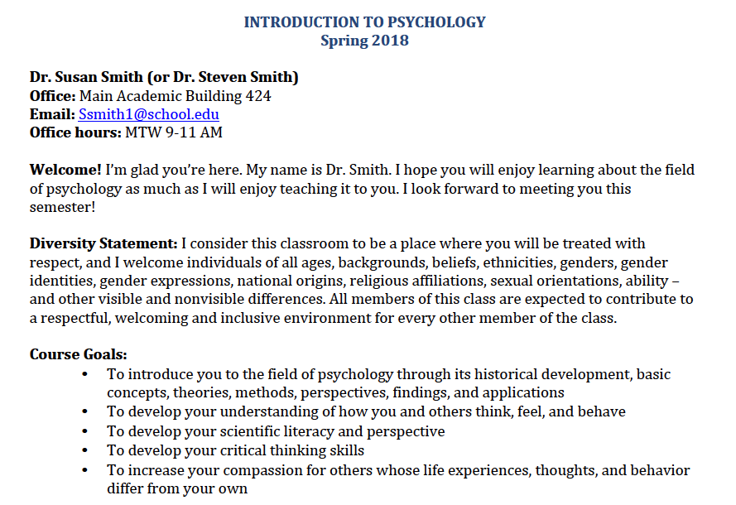
“Early” Condition
Notes:
Diversity statement appeared on the first page – seperate from the other course policies

Slide 10
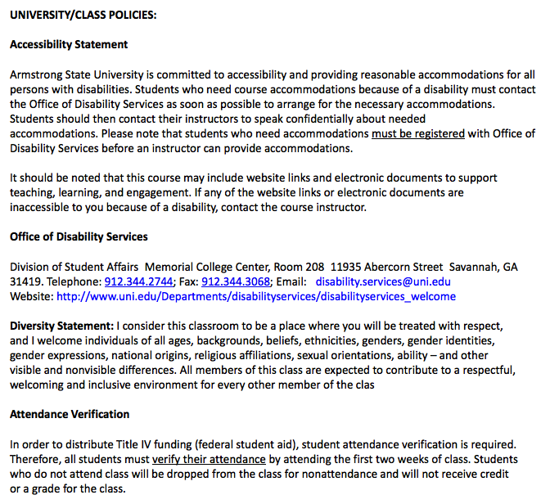
“Late” Condition
Notes:
In the late condition the statement appeared on the 3rd page – in the middle of the other course/university policies

Slide 11
Measures
Recall of diversity statement
Perceptions of Course Instructor
Competence, character
Political ideology
Faculty characteristics (unbiased/fair)
Course
Classroom climate
Overall assessment
Person Variables
Perceived discrimination experiences on campus
Symbolic Racism
Right Wing Authoritarianism

Slide 12
Results

Slide 13
Does the placement of the statement affect whether students correctly recall if it was there?
 | Correct | Incorrect | Didn’t Remember
No Statement | 25.9% | 30.6% | 41.6%
Late Placement | 55.4% | 10.9% | 33.7%
Early Placement | 67.6% | 6.8% | 25.6%
Based on the odds ratio, the odds of students correctly recalling that there was a diversity statement in the syllabus were 1.679 times higher if the statement appeared earlier in the syllabus compared to later in the syllabus.
χ² (4) = 74.90, p = .000
Notes:
Use chi-square analyses to assess whether the placement of the statement affected whether students noticed it / remembered that it was there.

Slide 14
Did the inclusion of a diversity statement affect students perceptions of the course/instructor?
Perceptions of Instructor
Competence, character | x
Faculty characteristics (unbiased, fair) | x
Political ideology | ✓
Perceptions of Class
Classroom climate | ✓
Overall assessment | x

Slide 15
Did the inclusion of a diversity statement affect students perceptions of the course/instructor?
Perceptions of Instructor
Competence, character | x
Faculty characteristics (unbiased, fair) | x
Political ideology | ✓
Perceptions of Class
Classroom climate | ✓
Overall assessment | x

Slide 16
Did the inclusion of a diversity statement affect students perceptions of the course/instructor?
Perceptions of Instructor
Competence, character | x
Faculty characteristics (unbiased, fair) | x
Political ideology | ✓
Perceptions of Class
Classroom climate | ✓
Overall assessment | x

Slide 17
Did the inclusion of a diversity statement affect students perceptions of the course/instructor?
Perceptions of Instructor
Competence, character | x
Faculty characteristics (unbiased, fair) | x
Political ideology | ✓
Perceptions of Class
Classroom climate | ✓
Overall assessment | x

Slide 18
Did the inclusion of a diversity statement affect students perceptions of the course/instructor?
F(2, 255) = 3.398, p = .002

Slide 19
Did the inclusion of a diversity statement affect students perceptions of the course/instructor?
Perceptions of Instructor
Competence, character | x
Faculty characteristics (unbiased, fair) | x
Political ideology | ✓
Perceptions of Class
Classroom climate | ✓
Overall assessment | x

Slide 20
Did the inclusion of a diversity statement affect students perceptions of the course/instructor?
Perceptions of Instructor
Competence, character | x
Faculty characteristics (unbiased, fair) | x
Political ideology | ✓
Perceptions of Class
Classroom climate | ✓
Overall assessment | x

Slide 21
Did the inclusion of a diversity statement affect students perceptions of the course/instructor?
F(2, 255) = 4.220, p = .016
Notes:
There was a significant effect of placement of the diversity statement on perceptions of classroom climate, F(2, 255) = 4.220, p = .016. There was a significant linear trend, F(1, 255) = 8.022, indicating that as the placement moved from none, to late, to early, perceptions of classroom climate increased proportionately. Planned contrasts revealed that the presence of a diversity statement, regardless of where it appeared, increased positive perceptions of classroom climate compared to having no diversity statement, t(255) = 2.358, p = .019. Additionally, placing the diversity statement earlier in the syllabus compared to later in the syllabus increased positive perceptions of the classroom climate, t(255) = 30.925, p =.000.

Slide 22
Did the inclusion of a diversity statement affect students perceptions of the course/instructor?
Perceptions of Instructor
Competence, character | x
Faculty characteristics (unbiased, fair) | x
Political ideology | ✓
Perceptions of Class
Classroom climate | ✓
Overall assessment | x

Slide 23
Did the inclusion of a diversity statement affect students perceptions of the course/instructor?
Perceptions of Instructor
Competence, character | x
Faculty characteristics (unbiased, fair) | x
Political ideology | ✓
Perceptions of Class
Classroom climate | ✓
Overall assessment | x
Notes:
These analyses were run only for those people who correctly identified that there was a diversity statement (N = 258)

Slide 24
Conclusions

Slide 25
Conclusions
Placement of the diversity statement (earlier or later in the syllabus) affected whether students noticed it
If we want the inclusion of a diversity statement to influence the climate of the classroom, students have to be aware of the statement
Positioning the diversity statement on the front page led students to perceive the class climate as warmer and the professor as more liberal

Slide 26
What did students think?
Common suggested edits
Explicitly state what the consequences are for not abiding by the policy
Clearly indicate what students should do (who they should talk to and how) if they feel disrespected in the class
Overall, students were very positive about the statement
But pointed out the difference between theory and practice
Notes:
After completing all measures we asked students to read the diversity statement (separate from the syllabus evaluation) and asked whether they thought it should be edited in any way. There responses were telling. Most students said they thought the statement was great. But common edits included that the statement should explicitly list consequences for not acting in accordance with the statement and that it needs to clearly identify what students should do (who they should talk to and when) if they feel disrespected in the classroom. Another common statement was that it was too long and didn’t need to identify so many groups of people.

Slide 27
What did students think?
“I believe this is a really good statement. Coming from a Hispanic background, I would like to read this in our syllabus more often. I have not encountered any professor where they single out a students based on their ethnicity or beliefs. But I like the statement.”
“I've never seen a diversity statement like that, I wouldn't change it.”
“I don't see anything wrong with this statement. If I was a student that was reading this statement it would give me the sense of confront in the classroom.”
Notes:
After completing all measures we asked students to read the diversity statement (separate from the syllabus evaluation) and asked whether they thought it should be edited in any way. There responses were telling. Most students said they thought the statement was great. But common edits included that the statement should explicitly list consequences for not acting in accordance with the statement and that it needs to clearly identify what students should do (who they should talk to and when) if they feel disrespected in the classroom. Another common statement was that it was too long and didn’t need to identify so many groups of people.

Slide 28
What did students think?
“I would be very comfortable in taking this instructor after reading this statement. I would just hope for the professor to actually follow through.”
“I think the statement is very inclusive of all the various kinds of people that exist. However, a statement is not necessarily an indicator of things in practice, so while it is comforting to see, it may not be completely followed by the professor or other students unless they are held to it with high standards.”

Slide 29
Questions?
Notes:
In summary, it does appear that the inclusion of a diversity statement has the potential to positively influence students’ perceptions of the classroom climate, but the strongest effect is when the statement appears early (and in this case, separate from the other policies). We, as instructors, need to think about how the structure our syllabi (placement, etc.) affect the messages we send. The syllabus is a powerful tool for constructing the course expectations and culture. Of course, in a face-to-face course the students are getting information from many sources about the expectations for the course, but if a small change like the inclusion of a statement in the syllabus can contribute to more inclusive and respectful class climates, it seems a worthwhile investment.

Slide 30
Contact Us!
BRANCH@hws.edu Ho.Huynh@tamusa.edu lyra@psych.rutgers.edu Julie.Lazzara@paradisevalley.edu
‘

