Slide 1
Writing Testable Research Hypotheses
In-Class Activity

Slide 2
Goals of This Activity
Understand the structure of writing a testable research hypothesis
NOTE: This activity does not pertain to writing null and/or alternative hypotheses.
Practice writing individual components of both experimental and correlational research hypotheses
Operationally-defined variables
Levels of independent variables (in experimental approaches)
Apply both directional and non-directional approaches to writing testable hypotheses

Slide 3
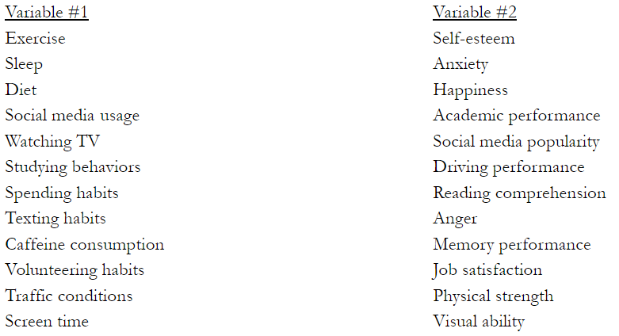
Step 1: Pick Your Variables
Pick one variable from the “Variable #1” list on the left
Pick one variable from the “Variable #2” list on the right
Does NOT have to be on the same line as your Variable #1 selection
Note that the variables in this walk-through are not on your list

Slide 4
Step 2: Write Your Variables in Appropriate Boxes
Write the variables you selected from the two lists in the Variables Table
In Box A, write your selection from the “Variable #1” list
In Box C, write your selection from the “Variable #2” list
screen time
visual ability

Slide 5
Step 3: Operationally Define Your Variables
For each of the variables you selected, write an operational definition that could be used in a hypothetical study
In Box B, write your operational definition of the Box A variable
In Box D, write your operational definition of the Box C variable
screen time
hours spent looking at digital screens
visual ability
score on an eye exam

Slide 6
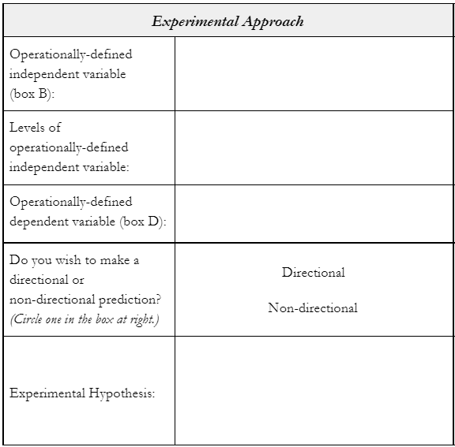
Step 4: Apply Operational Definitions to Experimental Approach
Write the operational definitions from the Variables Table in the appropriate boxes of the Experimental Approach section of the of the Hypothesis Table
hours spent looking at digital screens
score on an eye exam

Slide 7
Step 5: Define Levels for the Experimental Approach
Write 2-3 levels of the independent variable that will be compared in your experimental hypothesis
Should reflect operational definition of the independent variable
hours spent looking at digital screens
0 hours, 2 hours, 4 hours
score on an eye exam

Slide 8
Step 6: Decide on Directionality for the Experimental Approach
Indicate whether you wish to write a directional or non-directional hypothesis by circling the appropriate choice
hours spent looking at digital screens
0 hours, 2 hours, 4 hours
score on an eye exam

Slide 9
Step 7: Write Your Experimental Hypothesis
Using your operationally-defined dependent variable and levels of the independent variable, write a hypothesis that reflects the directional approach you selected
hours spent looking at digital screens
0 hours, 2 hours, 4 hours
score on an eye exam
There will be a significant difference in participants’ eye exam scores based on whether they experienced 0, 2, or 4 hours of time looking at digital screens.

Slide 10
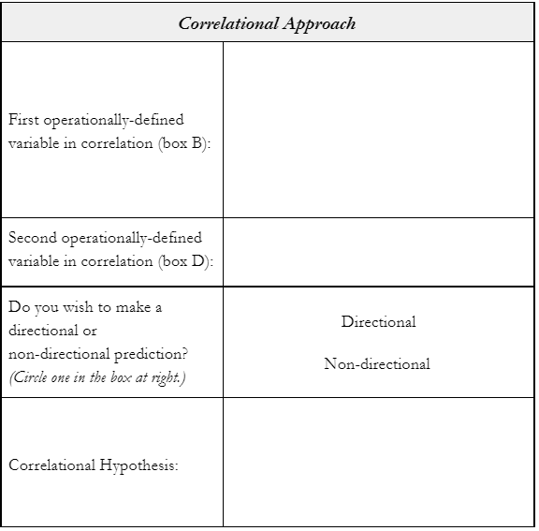
Step 8: Apply Operational Definitions to Correlational Approach
Write the operational definitions from the Variables Table in the appropriate boxes of the Correlational Approach section of the Hypothesis Table
hours spent looking at digital screens
score on an eye exam

Slide 11
Step 9: Decide on Directionality for Correlational Approach
Indicate whether you wish to write a directional or non-directional hypothesis by circling the appropriate choice
hours spent looking at digital screens
score on an eye exam

Slide 12
Step 10: Write Your Correlational Hypothesis
Using the operational definitions of your two variables, write a hypothesis that reflects the directional approach you selected
hours spent looking at digital screens
score on an eye exam
The number of hours spent looking at digital screens will be negatively correlated with eye exam scores.

Slide 13
Repeat All Steps for Variable Pairs 2-4
A few tips and reminders…
Do not use any variable twice! Your remaining 3 pairs should use 6 unique variable choices (in total).
Make sure you are writing hypotheses using the operational definitions you came up with rather than the conceptual definitions from the list.
Try to get practice with both directional and non-directional hypotheses for both experimental and correlational approaches.
Your wording needs to be definitive so that it can be refutable (i.e., use “will be” instead of phrases like “may be” or “could be”).

Slide 14
Tips for Experimental Hypotheses
Your hypothesis should make a prediction about the nature of differences between at least 2 levels of your independent variables.
Non-directional example:
[The operationally-defined dependent variable] will differ based on whether participants experienced [Level 1] or [Level 2] .
Directional example:
The [Level 1] group will yield higher [operationally-defined dependent variable measures] than the [Level 2] group.

Slide 15
Tips for Correlational Hypotheses
Your hypothesis should be written about holistic variables (i.e., eye exam scores) rather than ranges of those variables (i.e., high eye exam scores).
Non-directional example:
[Operationally-defined variable #1] will be significantly correlated with [operationally-defined variable #2] .
Directional example:
[Operationally-defined variable #1] will be negatively correlated with [operationally-defined variable #2] .

