Slide 1
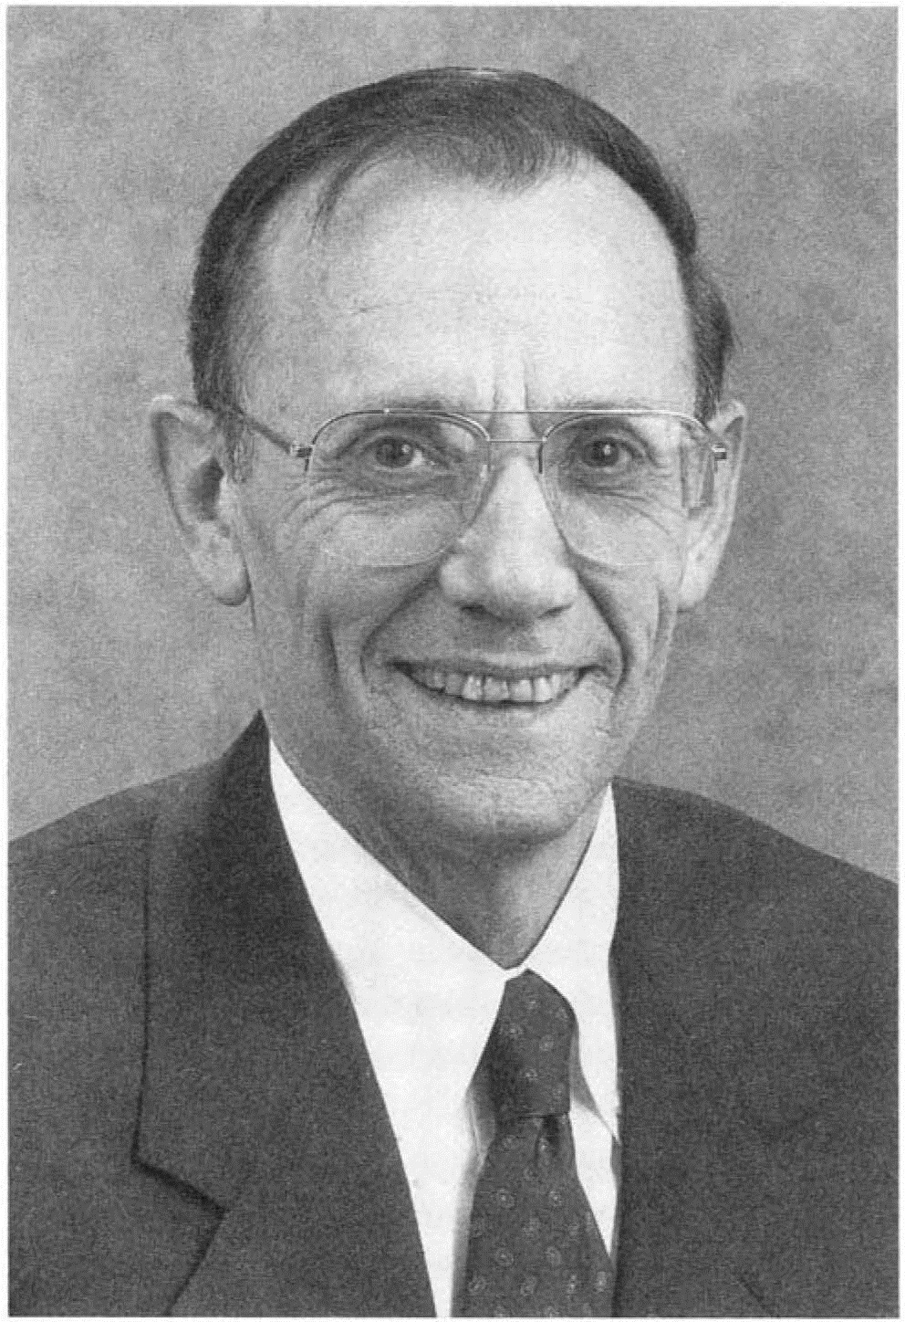
Community Farewell to Teaching of Psychology’s Hero: Charles Brewer
1932-2018
American Psychological Association Convention
Chicago, IL
August 9, 2019

Slide 2
Participants
Randy Smith—Moravian College
Diane Halpern—Minerva Schools at KGI;
Claremont McKenna College
Dorothy Cantor—American Psychological Foundation
Jane Halonen—University of West Florida
PLUS—a cast of 100s on video

Slide 3
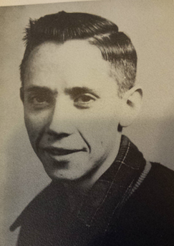
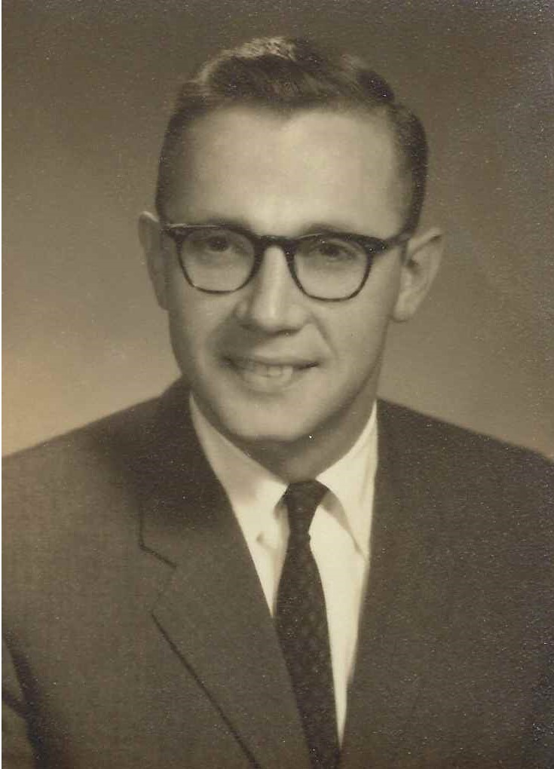
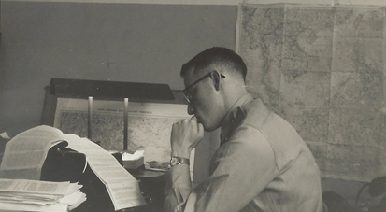

Slide 4
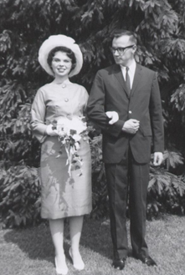
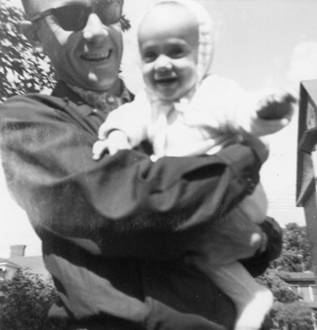

Slide 5
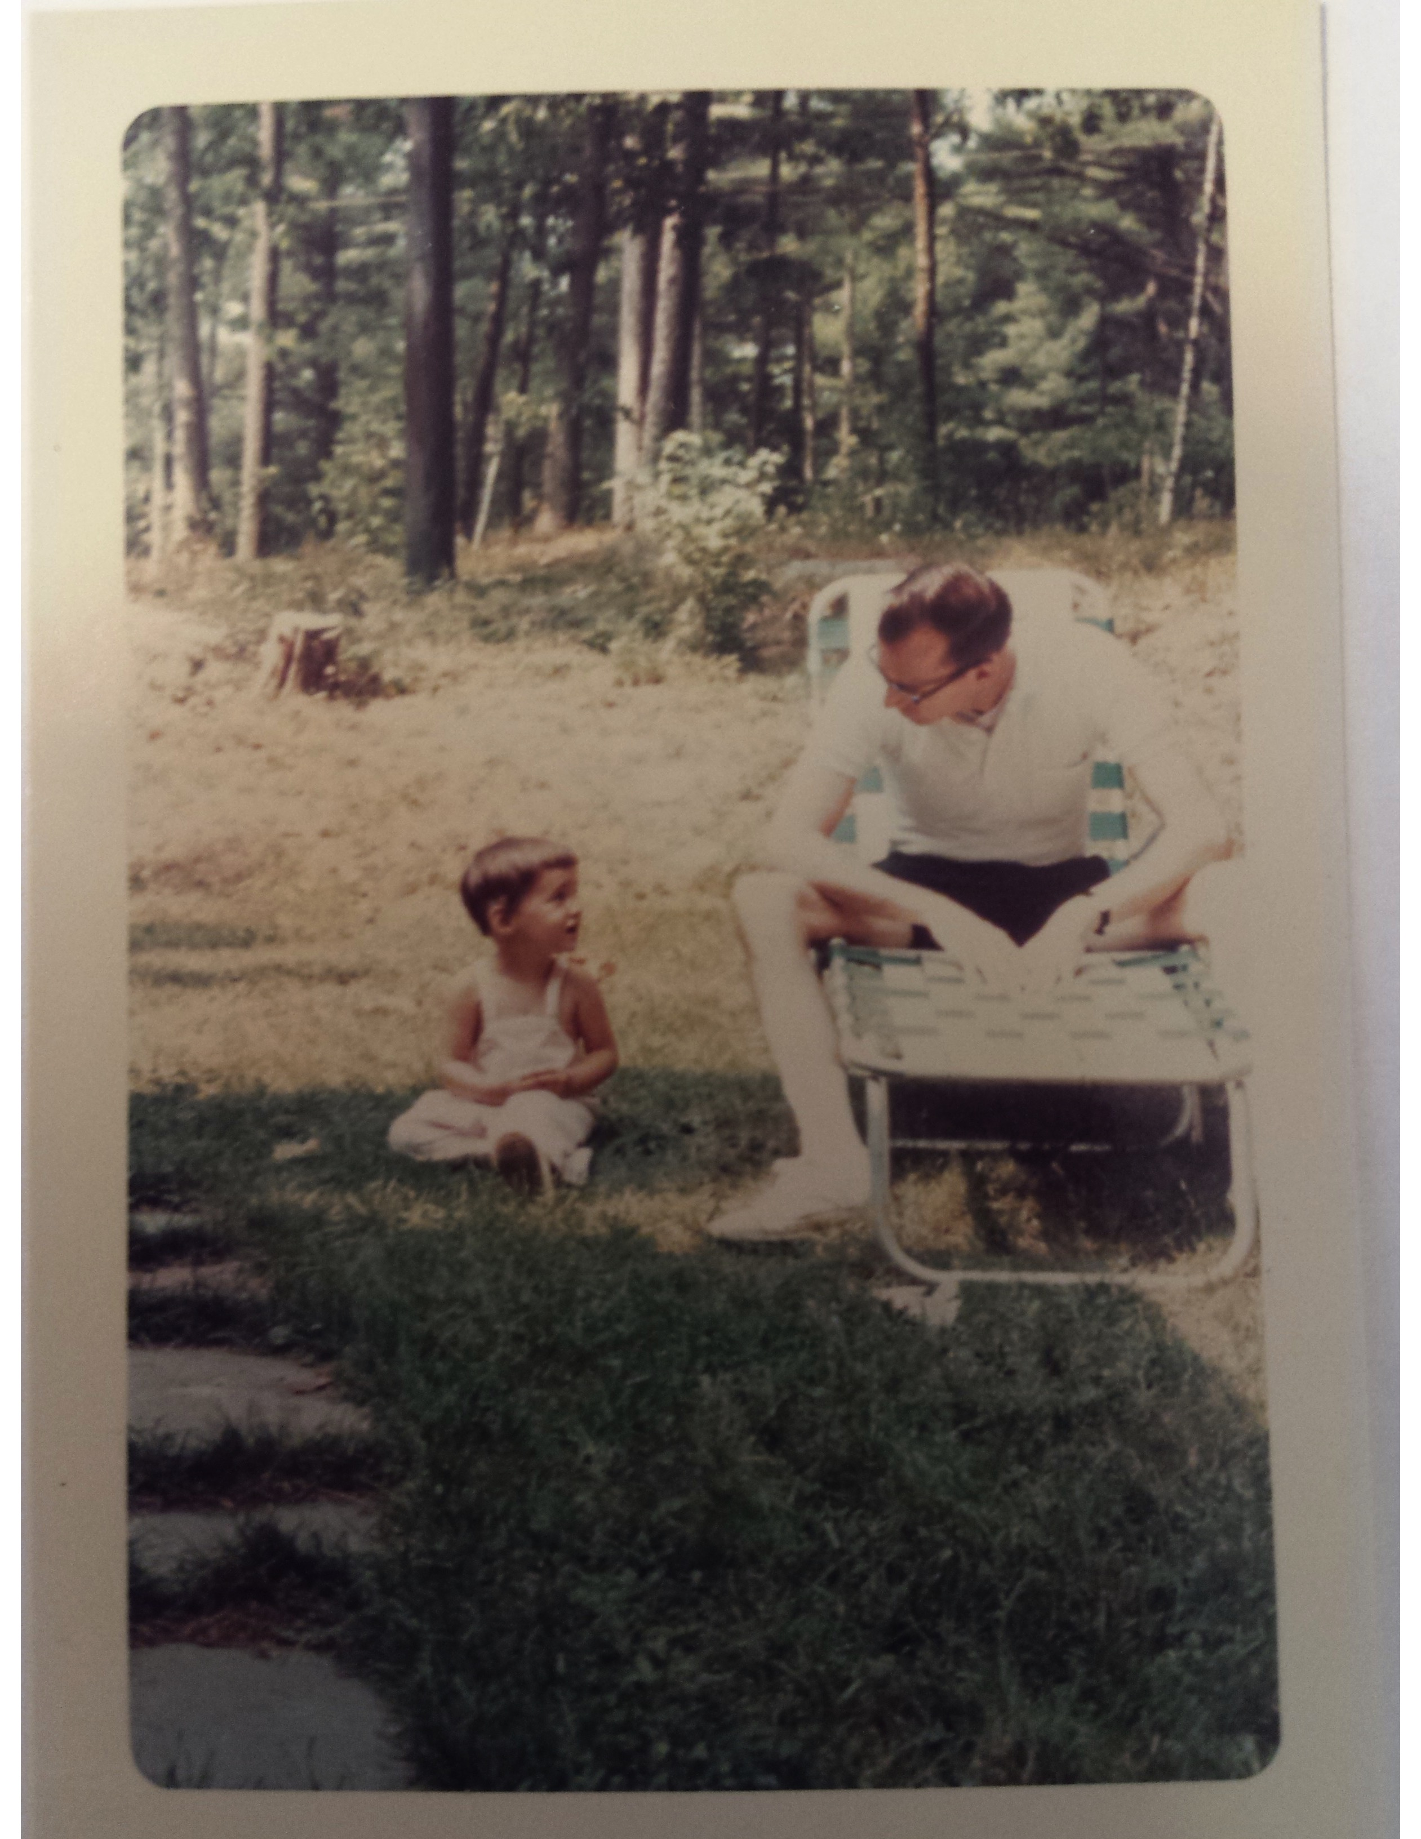
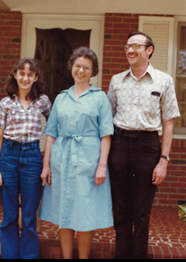

Slide 6
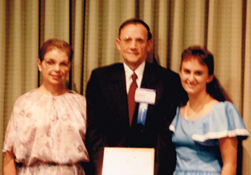

Slide 7
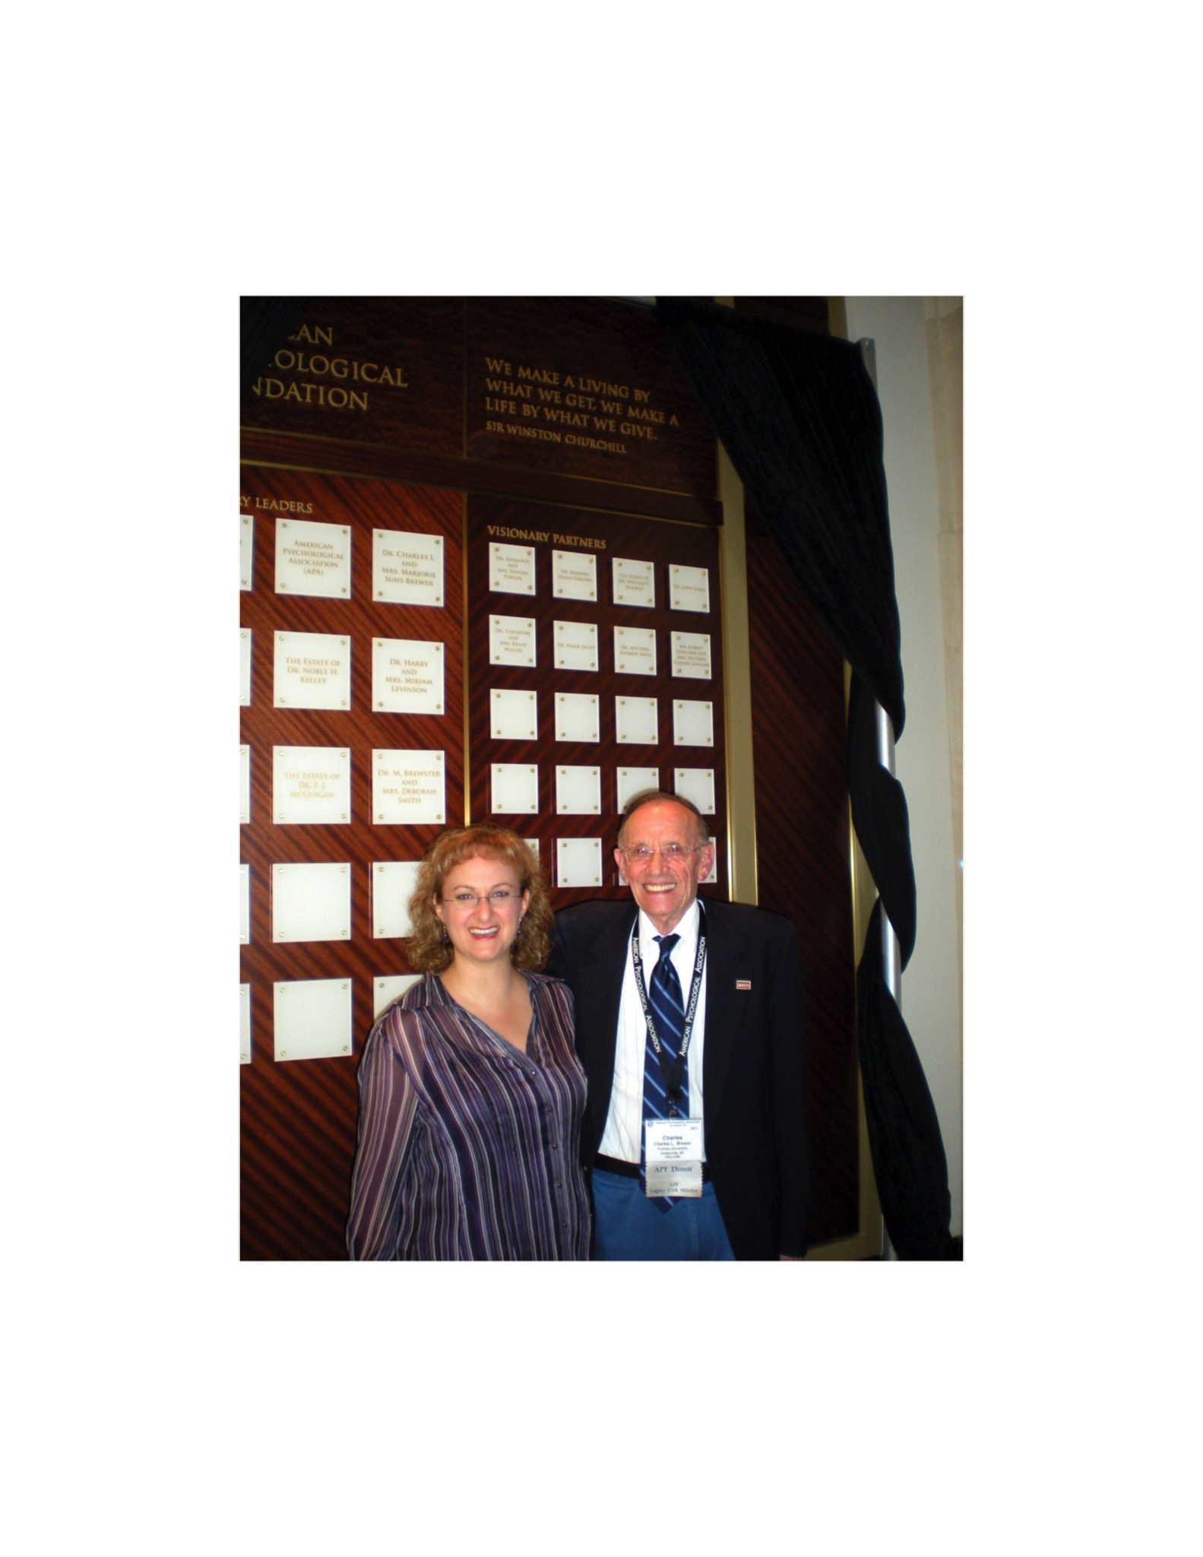

Slide 8
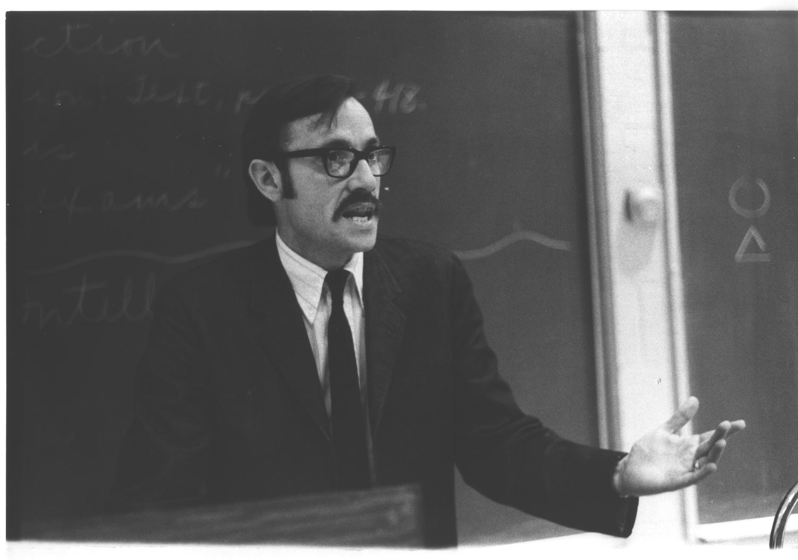
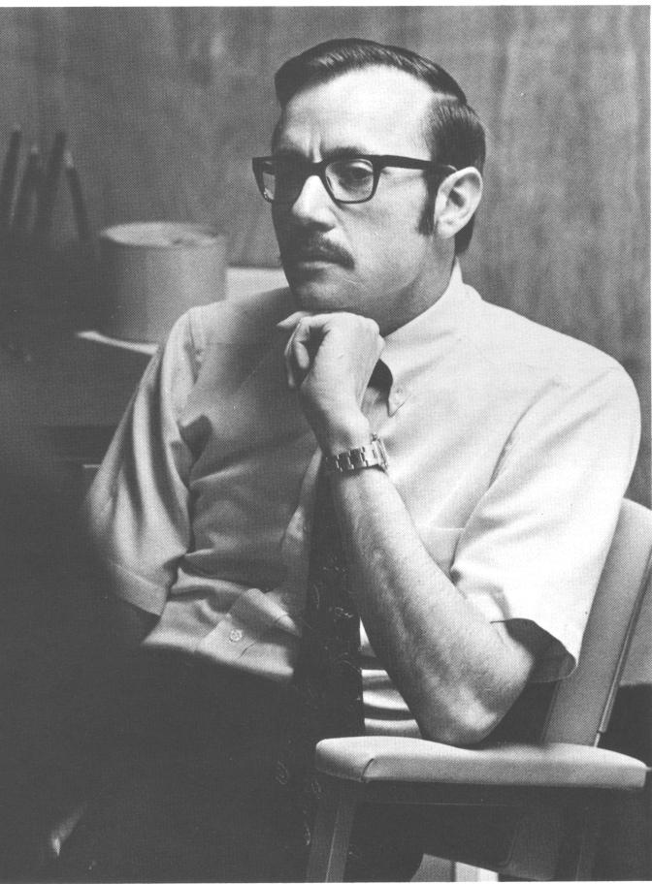
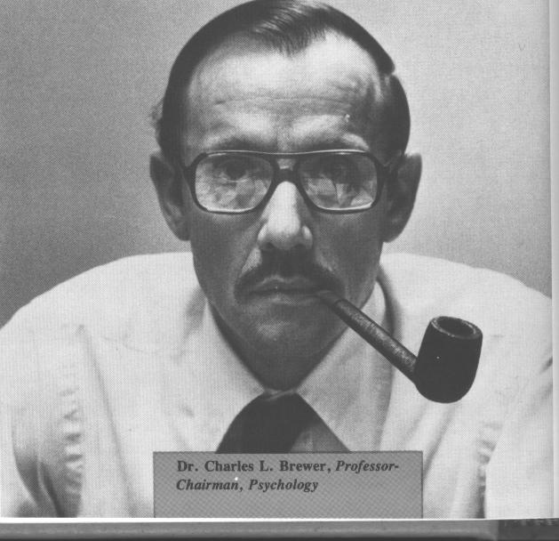

Slide 9
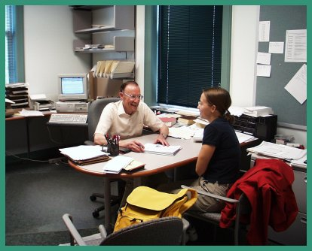
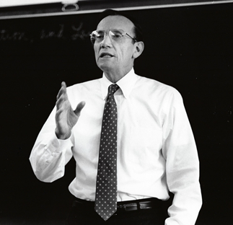

Slide 10
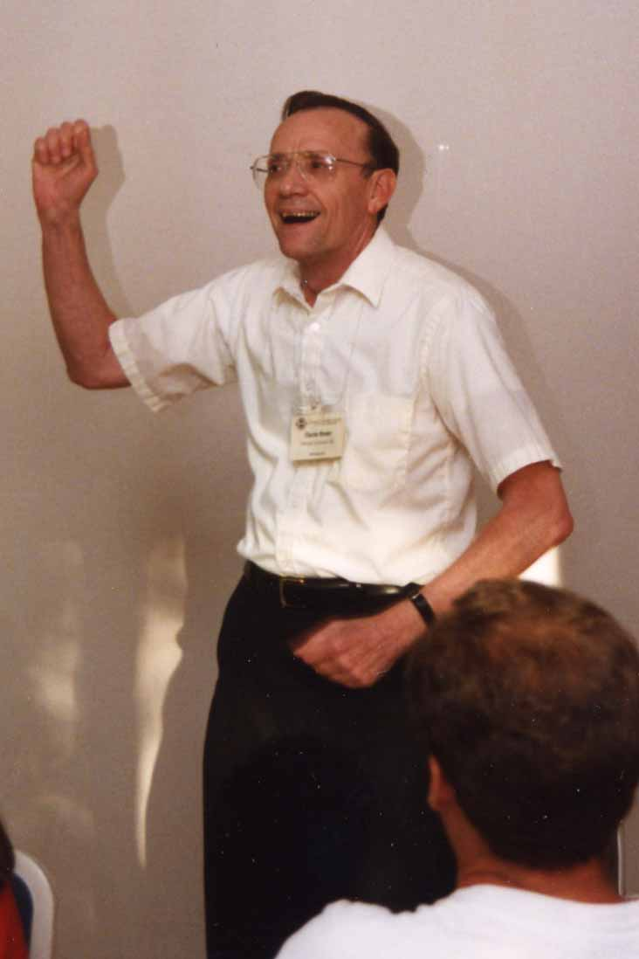
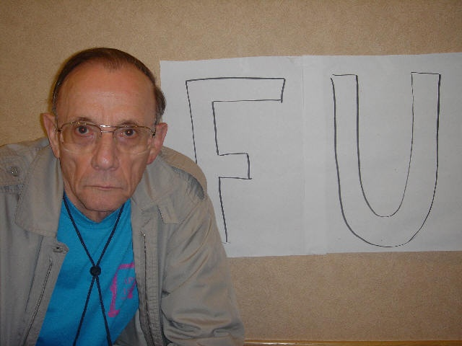

Slide 11
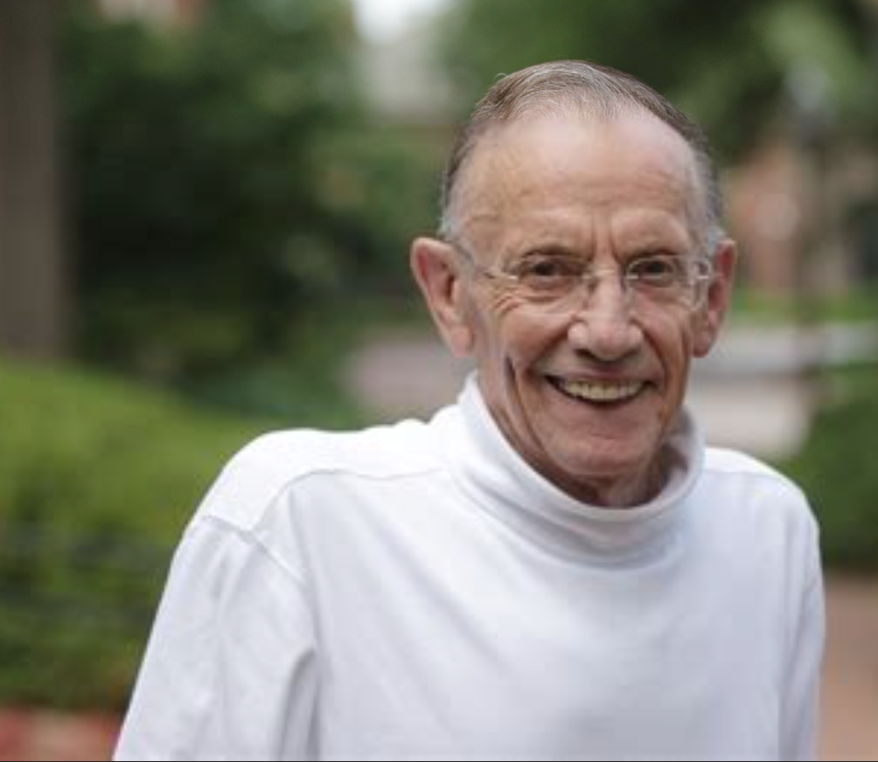

Slide 12
Awards & Accomplishments
Furman Award for Meritorious Teaching, 1969
Hendrix College Distinguished Alumnus, 1994
Named William Kenan Professor of Psychology, 1998
Furman Award for Meritorious Advising, 2010
President, Division Two APA, 1981-1982
Editor, Teaching of Psychology, 1985-1996
APF Distinguished Teaching Award, 1989
APF Teaching Award named in his honor, 2003
APA Award for Distinguished Career Contributions to Education and Training, 1995

Slide 13
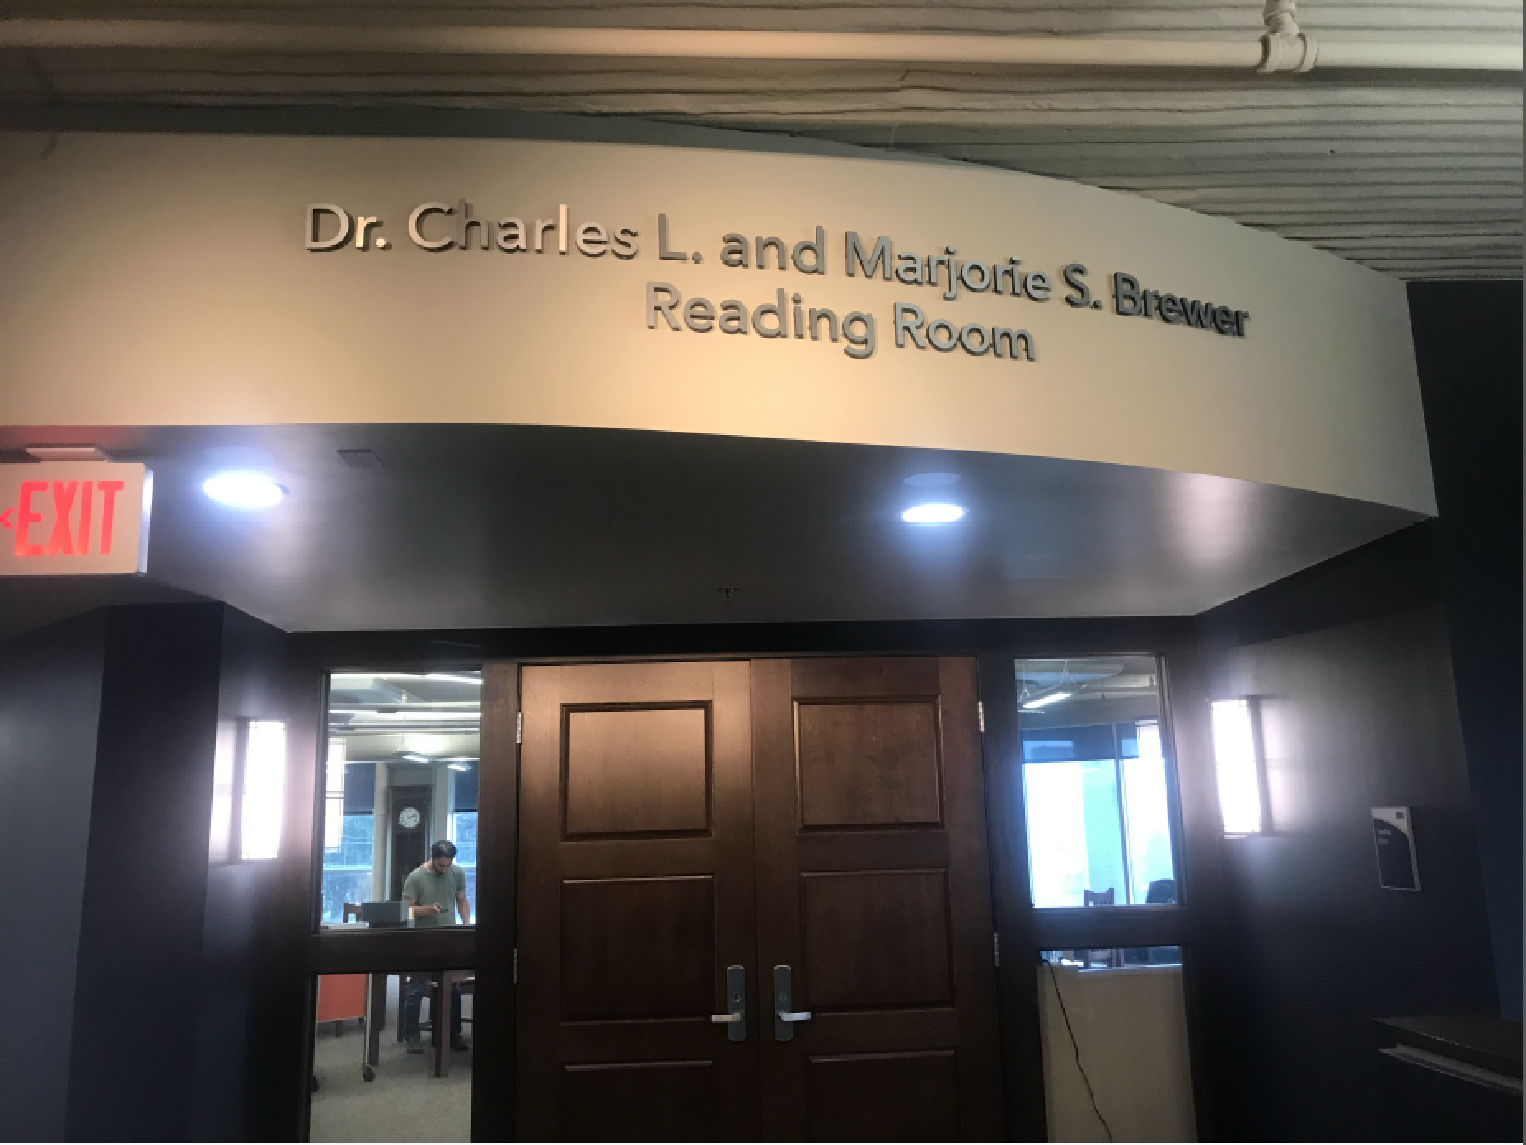

Slide 14
Facts fade fast, so learn concepts and principles
Randy’s First Brewerism

Slide 15
THINGS ALWAYS TAKE LONGER THAN THEY DO, ESPECIALLY WHEN THERE IS MORE WORK TO DO THAN TIME TO DO IT
Randy’s Second Brewerism

Slide 16
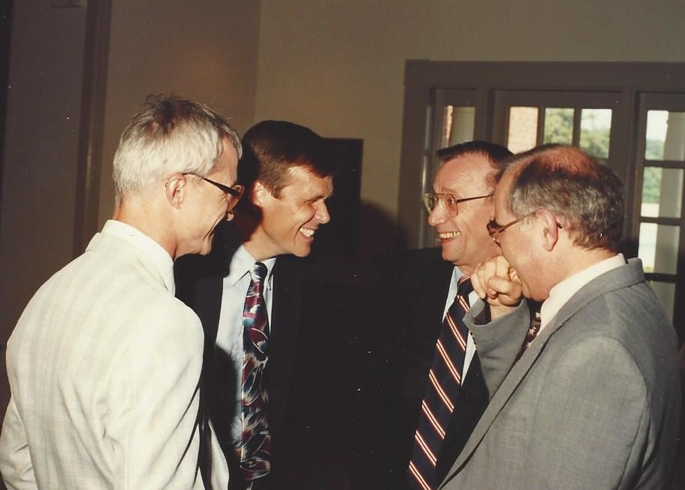

Slide 17
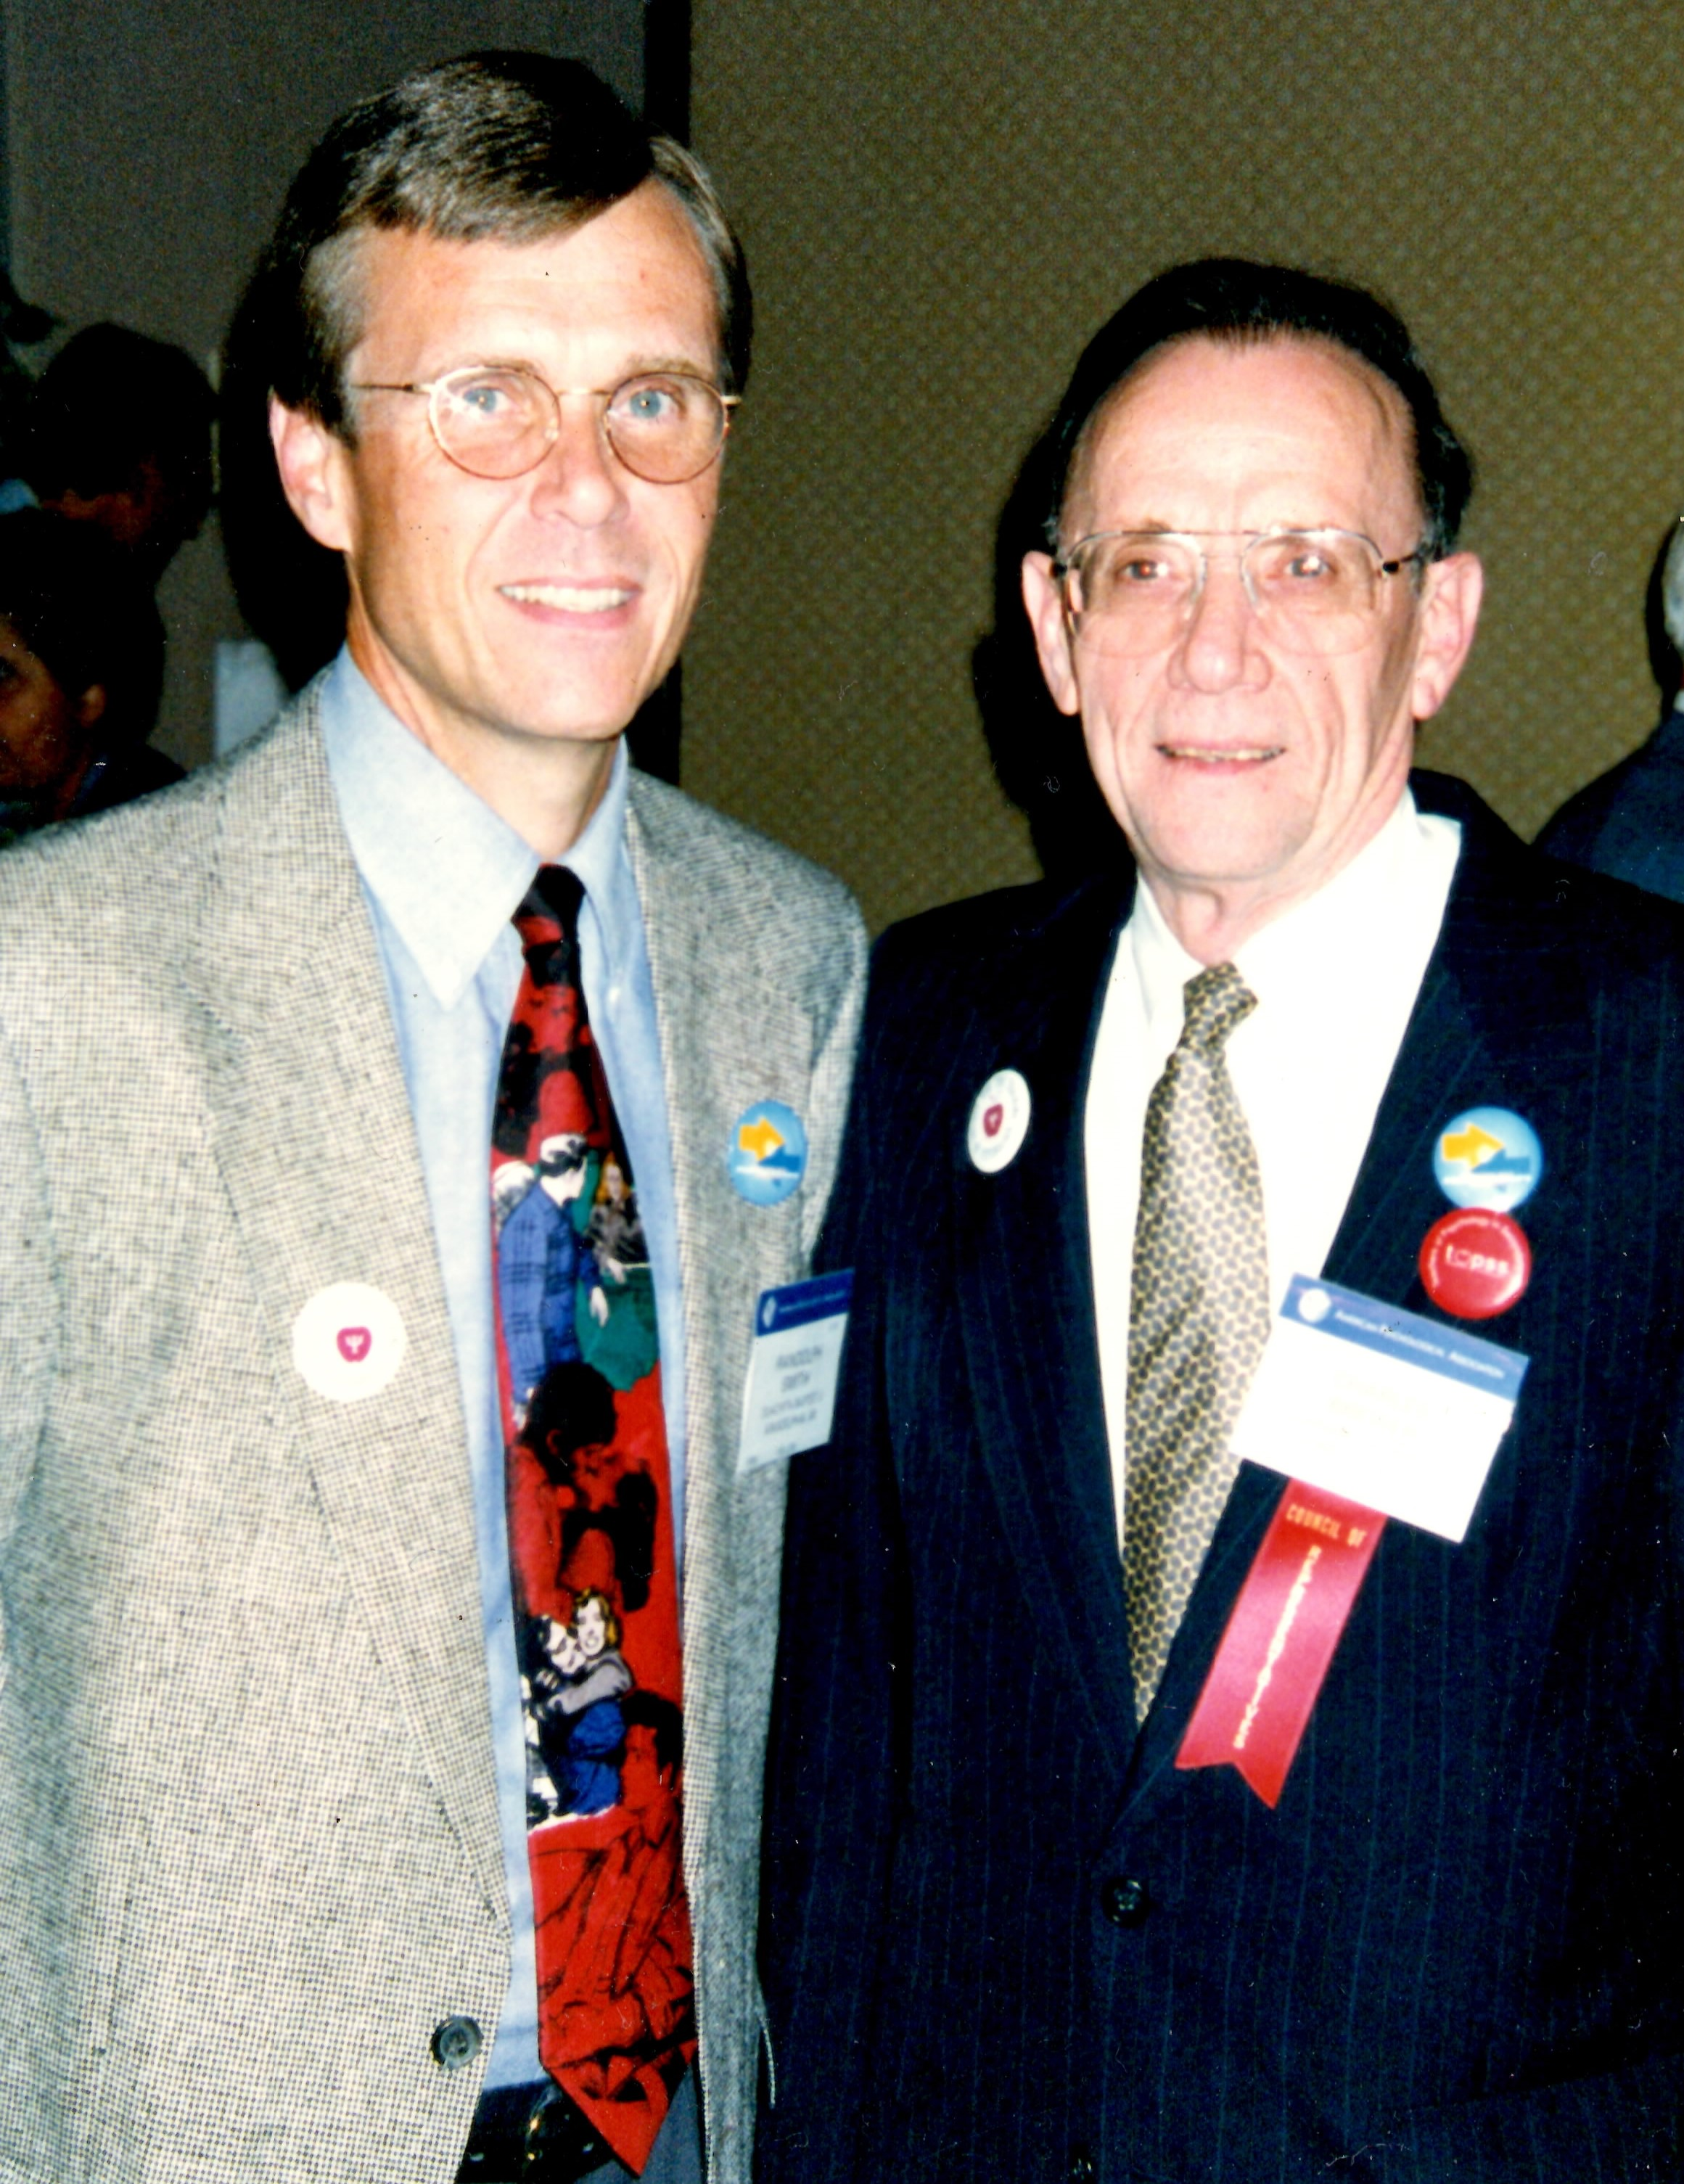
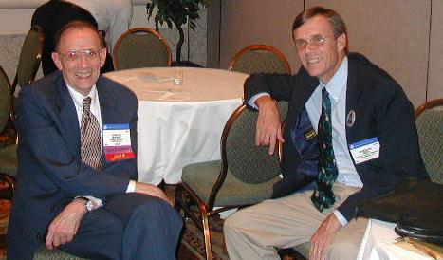

Slide 18
LIVE TRIBUTES
DIANE HALPERN
American Psychological Association
DOROTHY CANTOR
American Psychological Foundation

Slide 19
LEAVE NO ACADEMIC BUTT UNKICKED!
Diane’s Brewerism

Slide 20
I’ve been doing this so long, it goes way back to the last century…
Dorothy’s Brewerism

Slide 21
Remote tributes

Slide 22
GOOD TEACHERS INSPIRE STUDENTS TO DO BETTER THAN THEY CAN DO.
Jane’s Brewerism

Slide 24
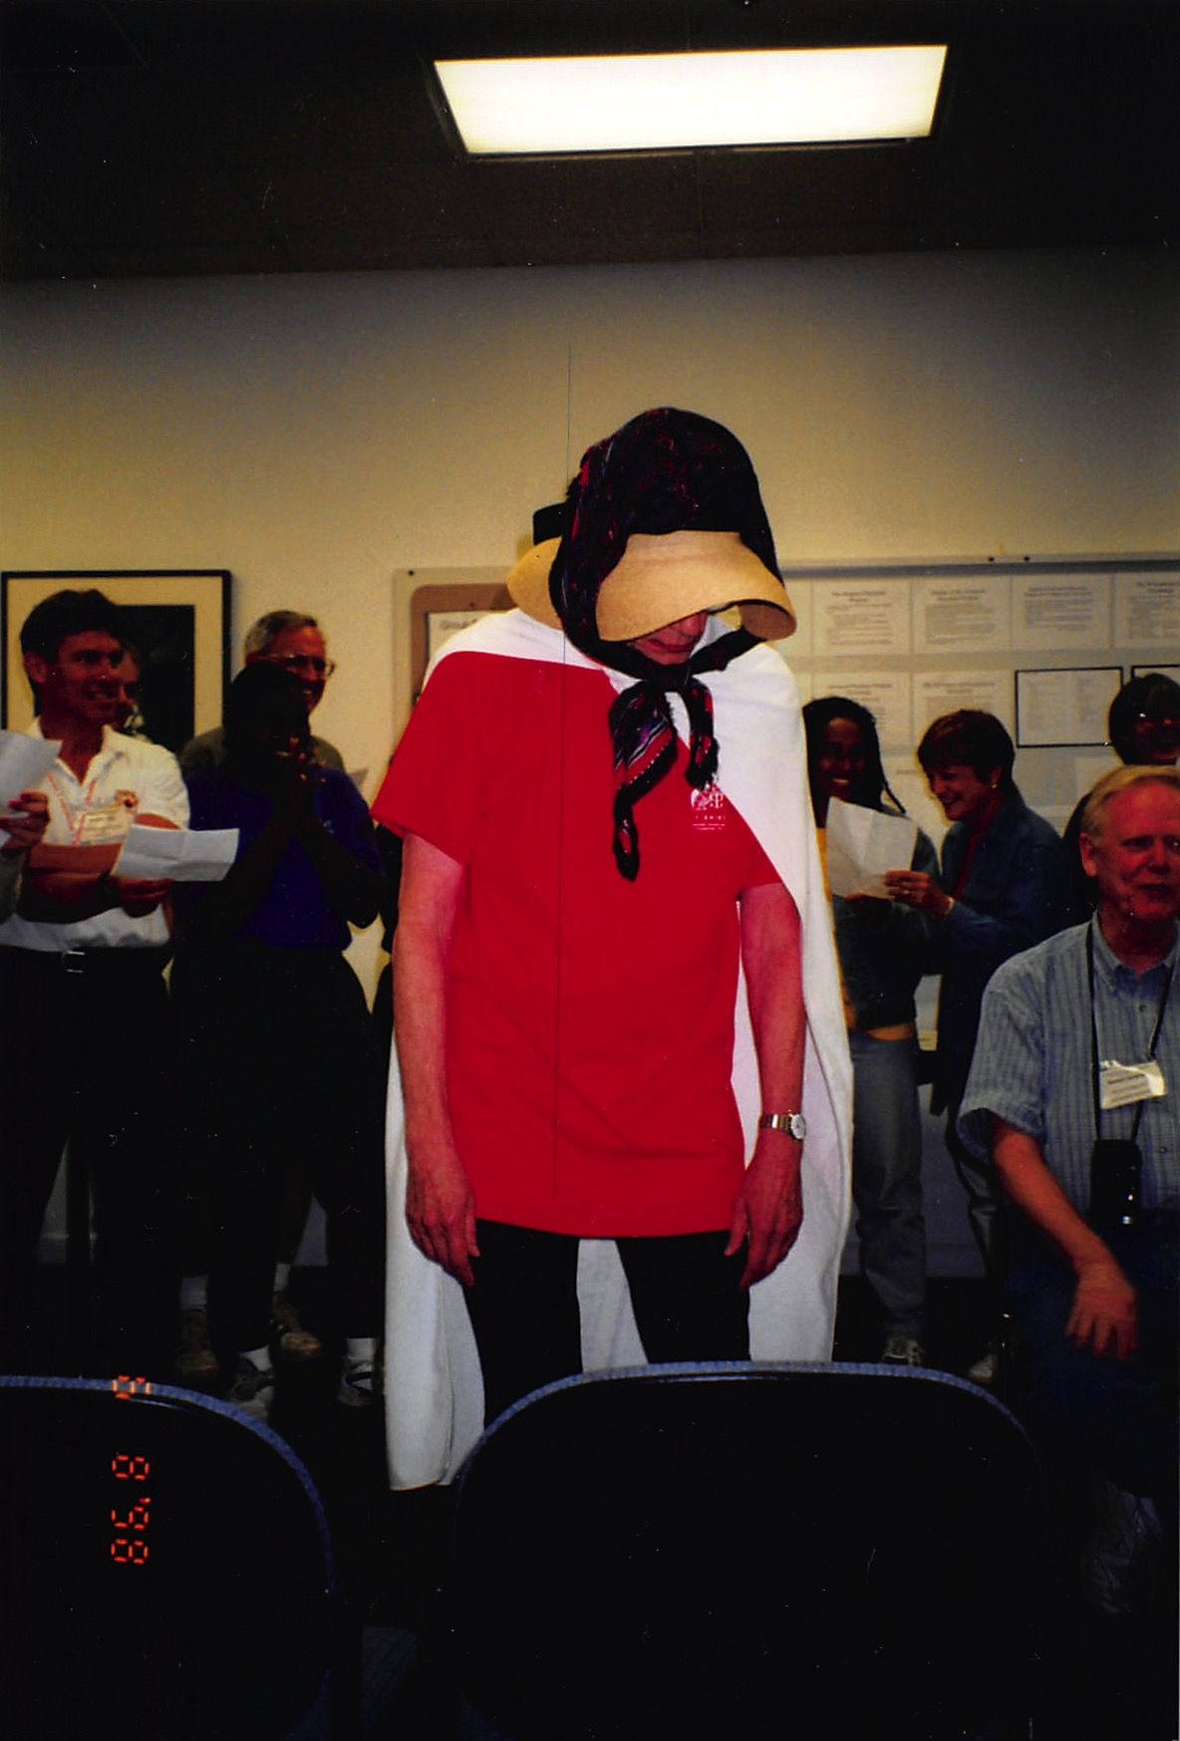
Dynamite Lady
At Advanced
Placement
Closing Night

Slide 26
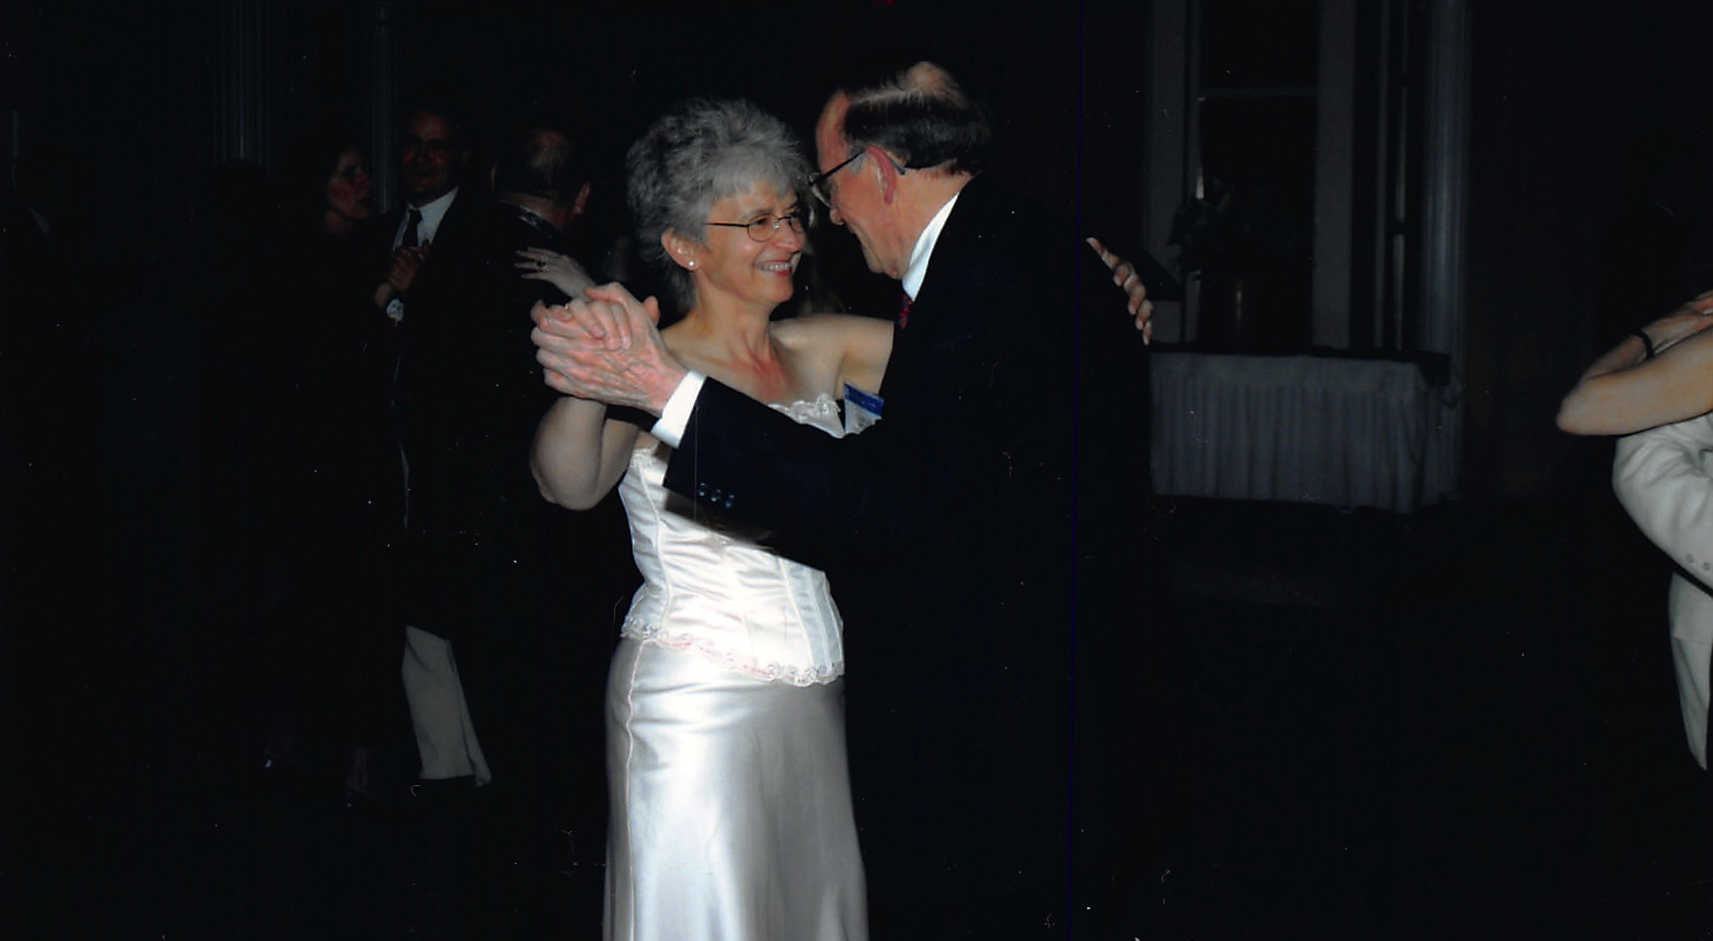
On firmer ground at APF Celebration

Slide 28
Closing tribute
https://www.youtube.com/watch?v=o7WusIhoits&t=41s

Slide 29
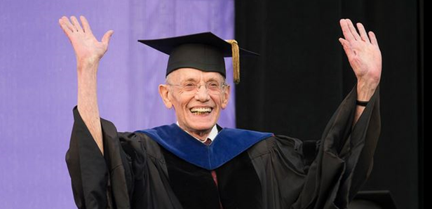
FAREWELL, CHARLES…

Slide 30
THANKS TO
Stephanie Foley
Furman Psychology Department “Seniors”
Brian Halonen
Opening Music: Finghin Collins, pianist; Erik Satie’s Gymnopedie #1

Slide 31
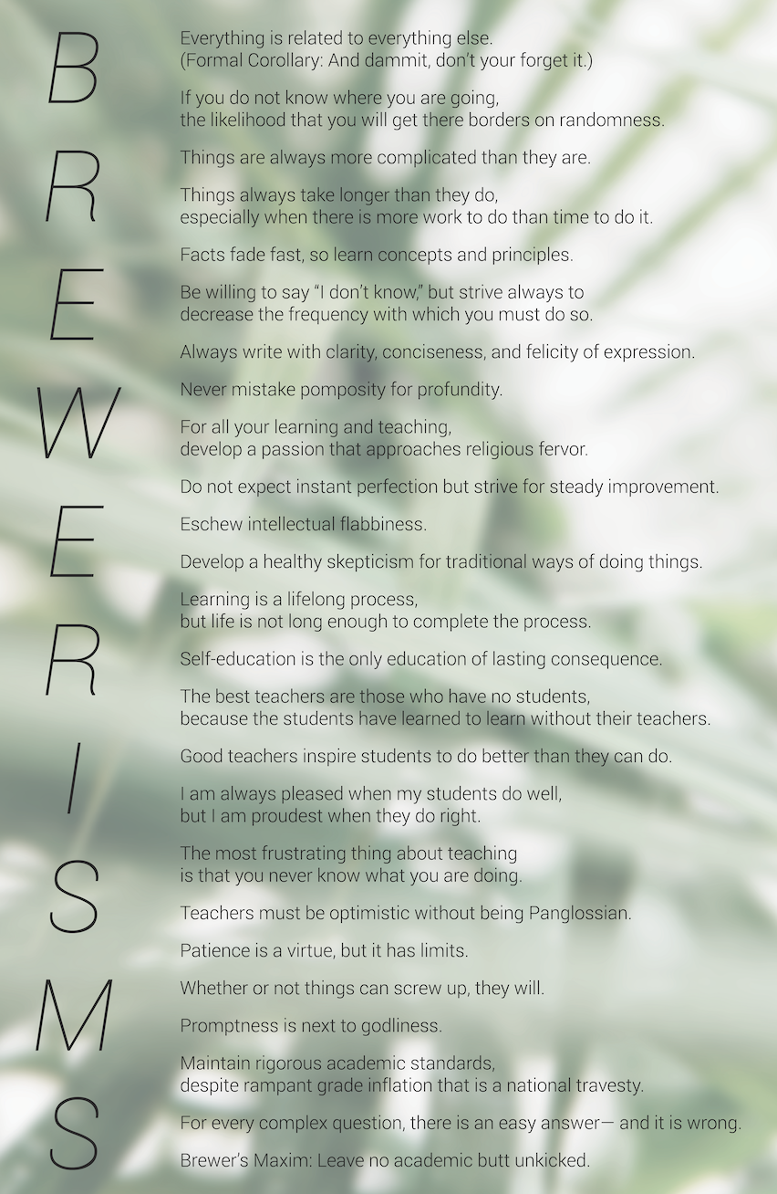
Get your copy of Brewerisms by http://teachpsych.org/resources/Documents/Brewerims%20Left.jpg

